Slide 1



Superstore Sales Data
View in Power BI
Last data refresh:
8/2/2021 8:30:06 PM UTC
Downloaded at:
8/2/2021 8:31:40 PM UTC

Slide 2
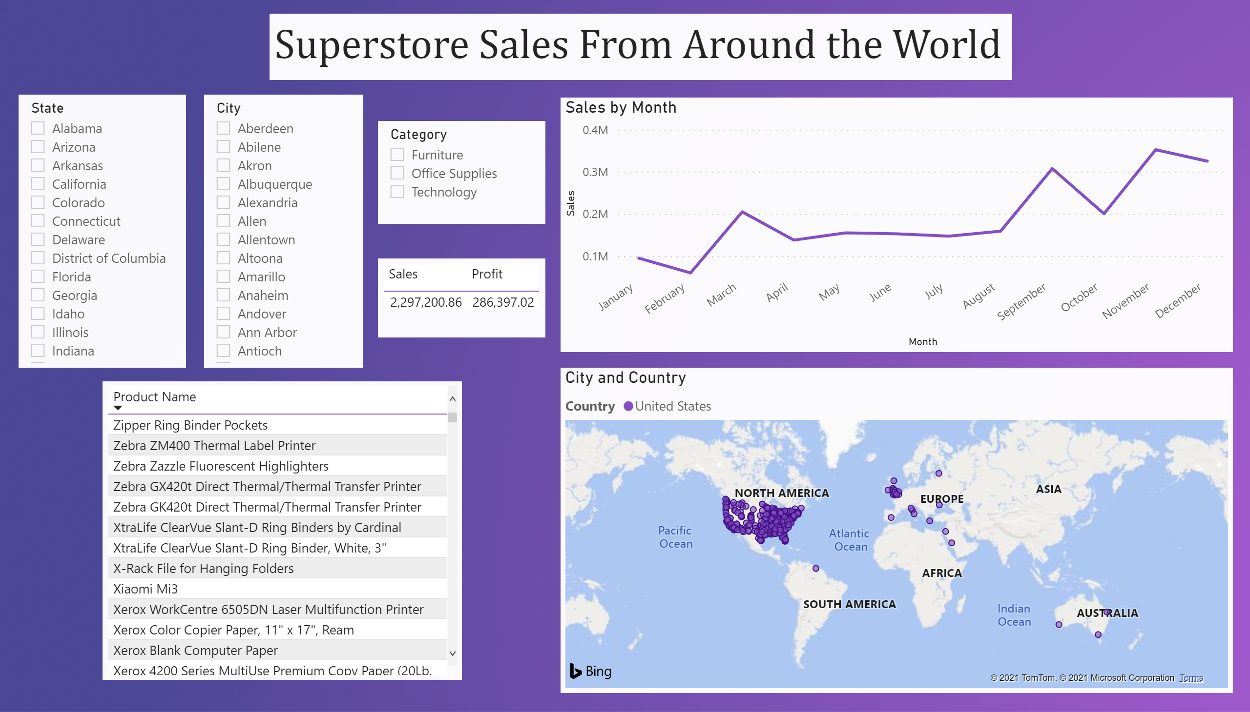
Page 1
Notes:
slicer
No alt text provided.
lineChart
No alt text provided.
slicer
No alt text provided.
tableEx
No alt text provided.
map
No alt text provided.
textbox
No alt text provided.
tableEx
No alt text provided.
slicer
No alt text provided.

